Slide 1
OOP Final Project
Group members: Amir, Ekaterina, Almas, Komron, Sanzhar G1 in G5

Slide 2
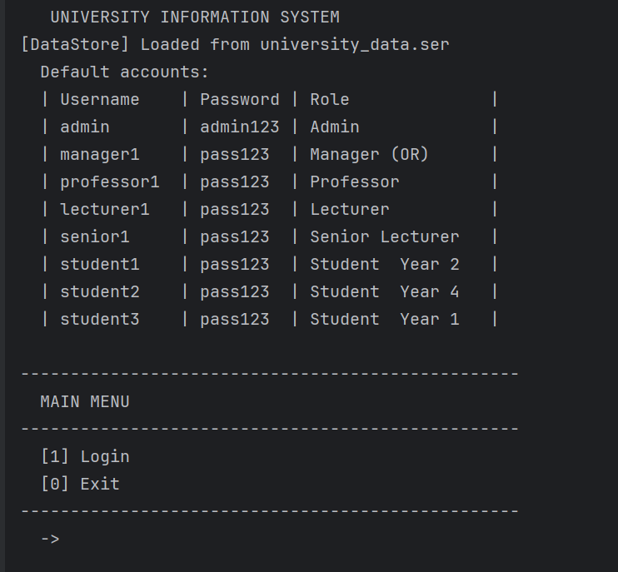
Project outputs
First run

Slide 3
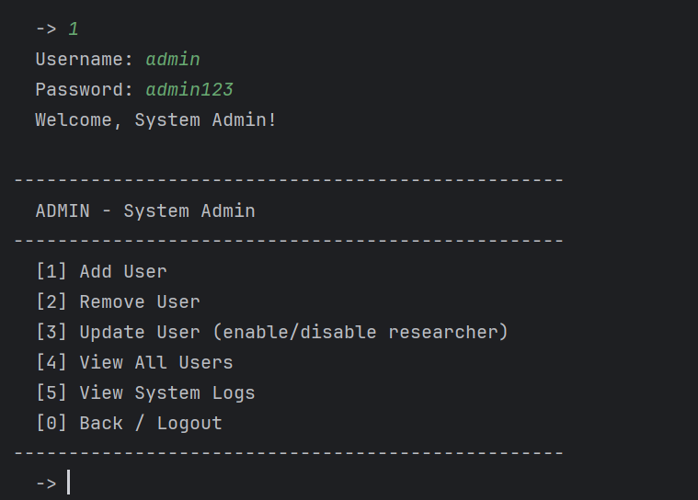
Project outputs
Log in as an Admin

Slide 4
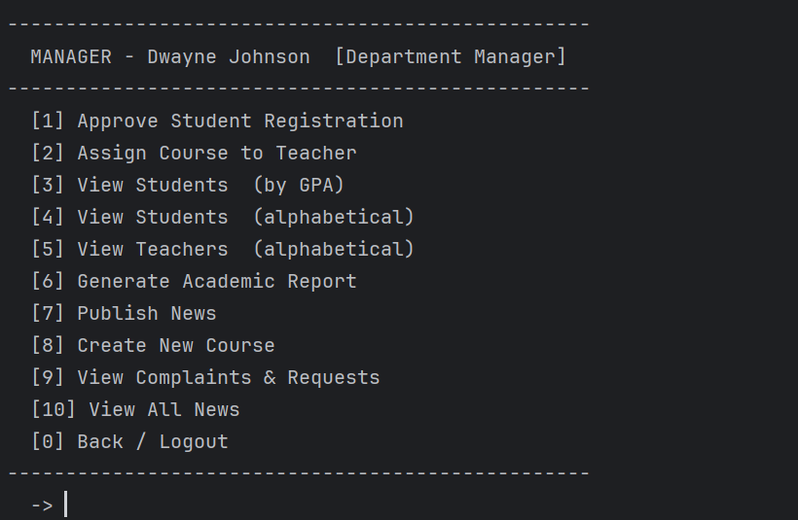
Project outputs
Log in as a Manager

Slide 5
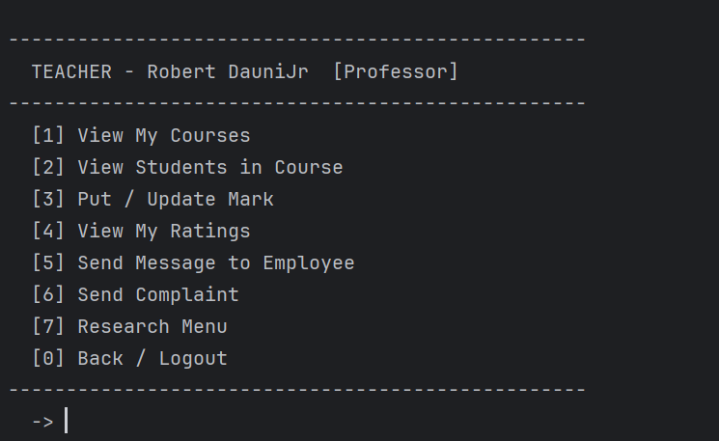
Project outputs
Log in as a Professor

Slide 6
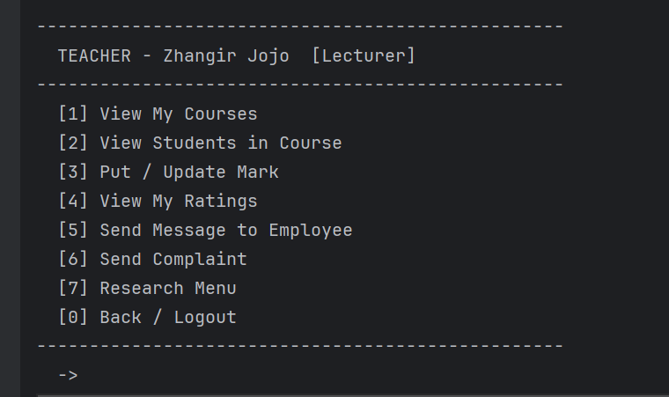
Project outputs
Log in as a Lecturer

Slide 7
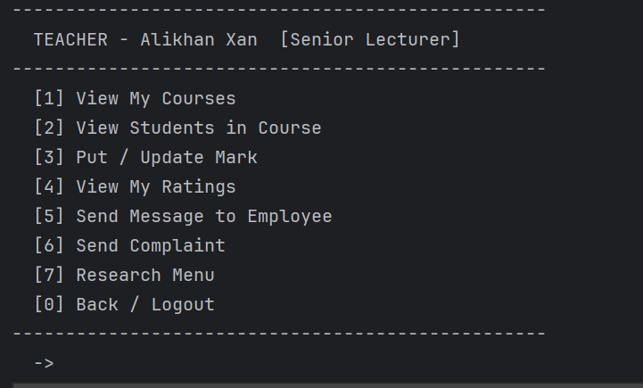
Project outputs
Log in as a Senior Lecturer

Slide 8
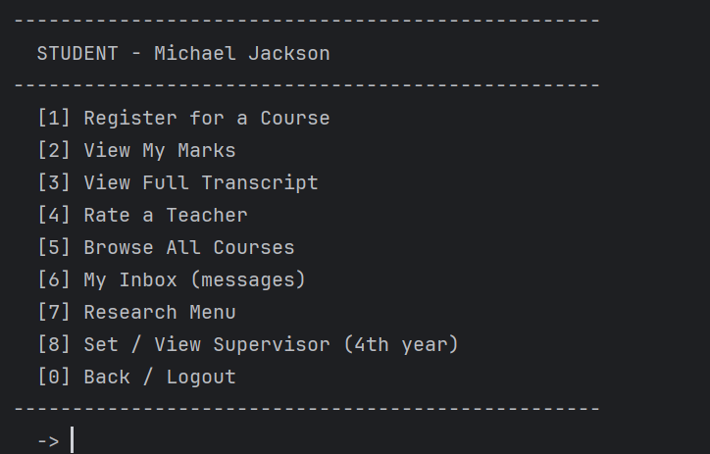
Project outputs
Log in as a Student

